Slide 1
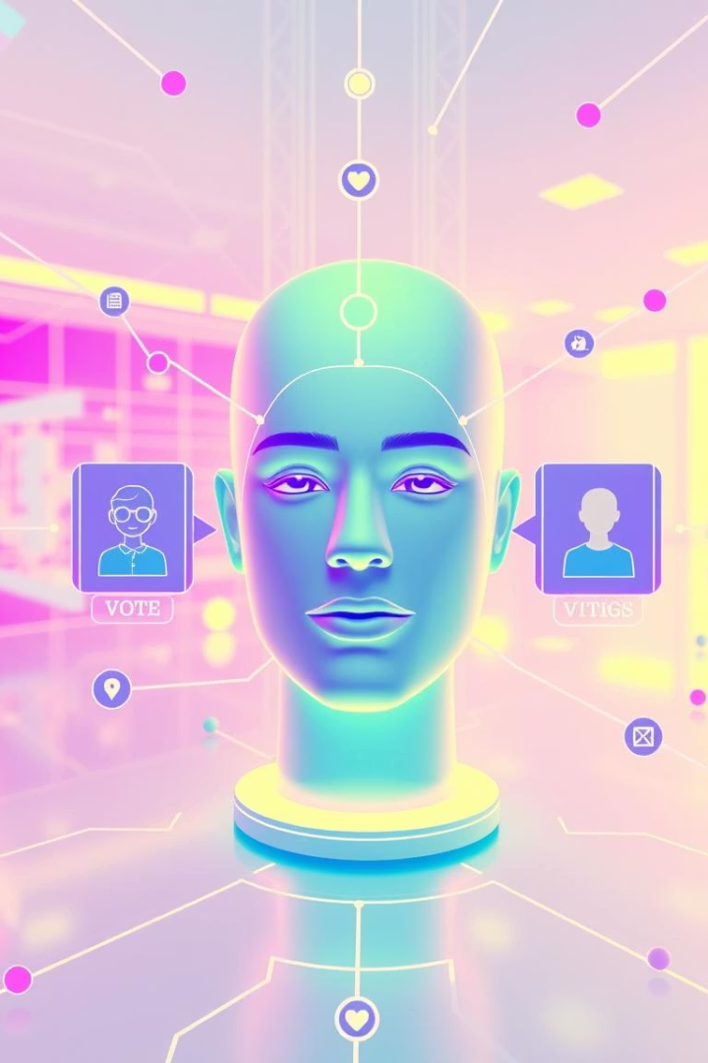
Blockchain Voting System using Face Recognition Voting System with DAO Governance
A Secure, Transparent, and Decentralized Approach to Voting using DAO
Prepared by G.V.ABHINAV KUMAR GUPTA – 23BCE1037
I.SRIRAJ – 23BCE1358
M.MOHITH – 23BCE1236

Slide 2

Foundations: Blockchain, Face Recognition, and DAO
Blockchain
Face Recognition
An immutable, transparent, and decentralized ledger technology that securely records every transaction and vote without alteration.
A biometric authentication technique that reliably verifies voter identity through unique facial features, preventing impersonation.
DAO (Decentralized Autonomous Organization)
Community-driven governance framework enabling decentralized decision-making on voting processes and system management.

Slide 3

Challenges in Traditional Voting Systems
Fraud and Vote Tampering
Low Accessibility
Susceptibility to manipulation and alteration of ballot data undermines election integrity.
Limited remote voting options reduce participation for certain demographics and those with mobility constraints.
Centralized Control
The Need for Decentralization
Traditional systems rely on central authorities, raising risks of censorship or bias.
Empowering citizens through decentralized governance is essential for transparent and trustworthy elections.

Slide 4
A Secure, Transparent, and Community-Governed Voting System
Integrated Solution
Key Features
Combines Blockchain's immutability, Face Recognition's authentication, and DAO's democratic governance.
Ensures one-person-one-vote authenticity
Immutable ledger for vote transparency
DAO-driven community decisions for system updates and validations

Slide 5

Our Proposed Blockchain & Face Recognition Solution
Decentralization
Immutability
Votes are recorded on a distributed ledger, eliminating centralized control and preventing data manipulation.
Blockchain ensures once a vote is cast, it cannot be altered or deleted, reinforcing vote integrity.
One-Person-One-Vote
Biometric face recognition guarantees unique voter authentication, preventing duplicate or fraudulent voting.

Slide 6





System Architecture & Workflow
Registration
Citizen data capture for voter eligibility and face data enrollment.
Face Verification
Biometric verification ensures secure voter identity confirmation at polling.
Vote Casting
Valid votes are submitted via smart contracts on blockchain.
DAO Governance
The DAO community validates vote tally and authorizes system changes.
Blockchain Record
Each vote is permanently and transparently recorded in the blockchain ledger.

Slide 7


Technologies Powering the System
Blockchain Platforms
Face Recognition Tools
Smart Contracts
Built with Solidity and Web3.js for trustless voting logic execution.
Ethereum and Hyperledger offer secure and scalable decentralized infrastructure.
OpenCV and Dlib provide robust facial biometric verification.
DAO Governance Framework
Utilizes Aragon and DAOstack for decentralized voting and community control.

Slide 8

Benefits of Blockchain-Based Face Recognition Voting
Security & Transparency
Decentralized Governance
Immutable records and biometric authentication greatly reduce fraud risks.
DAO enables citizen participation in system oversight and updates, boosting trust.
Remote Accessibility & Auditability
Voters can securely cast ballots from anywhere, with audit trails to validate results.

Slide 9
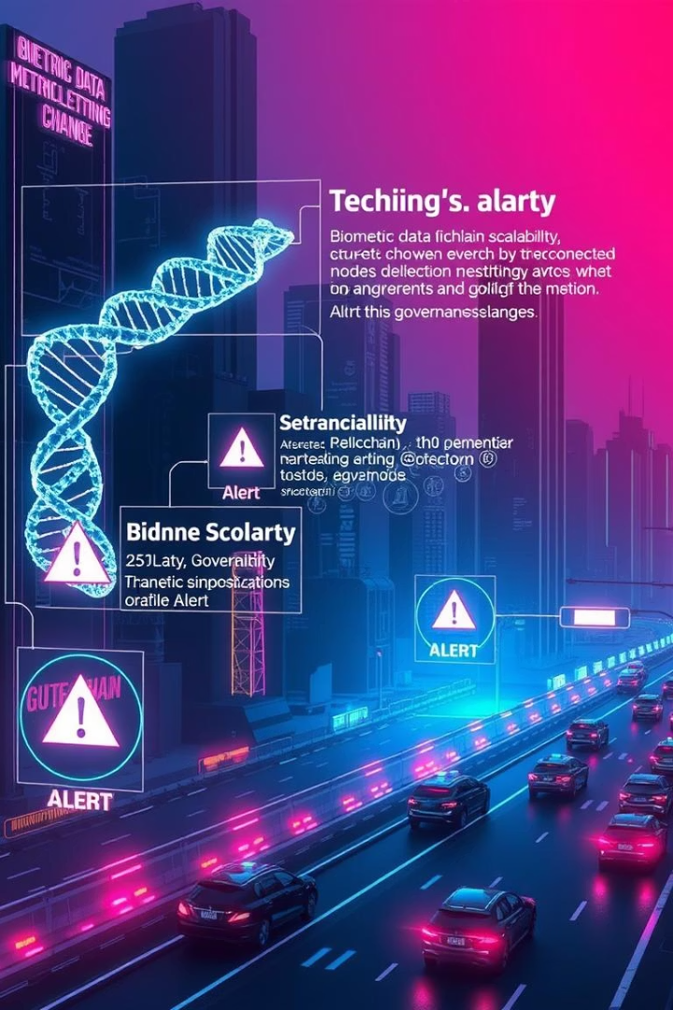
Challenges and Limitations to Overcome
Face Recognition Accuracy
Varying lighting, pose, and demographics can impact biometric reliability.
Biometric Privacy Concerns
Protecting sensitive face data from misuse or breaches is critical.
DAO Governance Delays
Decision deadlocks or voter apathy can slow system updates and validations.
Blockchain Costs & Scalability
Gas fees and transaction speeds limit large-scale deployment without optimization.

Slide 10
Purpose of Using DAO in the Voting System
A DAO enables community-driven decision-making without relying on a central authority. In the context of your
secure voting system, DAO is used to:
1. Empower Voters Beyond Elections
In traditional voting systems, people vote only for candidates or parties. But here, the DAO adds a second layer
of democracy by allowing users to:
Propose new rules or improvements (e.g., "Add mobile voting", "Change vote verification method").
Vote on proposals submitted by others.
See which proposals got accepted or rejected.
➡️ This makes the system interactive, dynamic, and community-driven.
2. Transparent Governance Using Blockchain
Each proposal, vote, and decision is stored transparently and immutably:
Ensures no one can tamper with the rules or results.
Makes governance traceable just like how votes are traceable on the blockchain.
➡️ Voters trust the system more when decisions are visible and secure.

Slide 11
Purpose of Using DAO in the Voting System
3. Decentralization & Automation
The DAO logic is:
Decentralized: No admin or authority can change proposals or votes.
Automated: When a proposal gets enough votes (e.g., 3 YES), it is auto-accepted or rejected based on conditions.
➡️ This eliminates manual control, allowing the system to run on pure community consensus.
4. Education & Real-world Simulation
For a student project, DAO also shows:
Understanding of blockchain governance.
Practical simulation of future digital democracies.
Integration of real voting + governance + face security.

Slide 12
Conclusion and Future Enhancements
Summary
1
A decentralized, secure, and accessible voting solution integrating blockchain, biometrics, and DAO governance.
Advanced Liveness Detection
2
Integrating spoof-resistance to strengthen biometric security.
Zero-Knowledge Proofs
3
Enhance voter privacy while maintaining auditability and trust.
Government-Level DAO
4
Scaling governance mechanisms for national or regional electoral bodies.
Nationwide Roll-Out
5
Phased deployment to enable remote transparent voting for millions.

Slide 13
Conclusion and Future Scope
The integrated Blockchain and Face Recognition voting system offers a revolutionary way to secure democratic elections, combining transparency, accessibility, and tamper resistance.
Enhancing liveness detection to prevent spoofing
Nationwide deployment for broader adoption
Compliance with evolving privacy laws and protections
While challenges exist, continuous advancements in biometric technology and blockchain scalability will enhance system effectiveness.

